Slide 1
Lessons for
Matrimonial lawyers FROM true-crime tv
Dr. Brian Russell
Licensed Psychologist & Attorney at Law

Slide 2
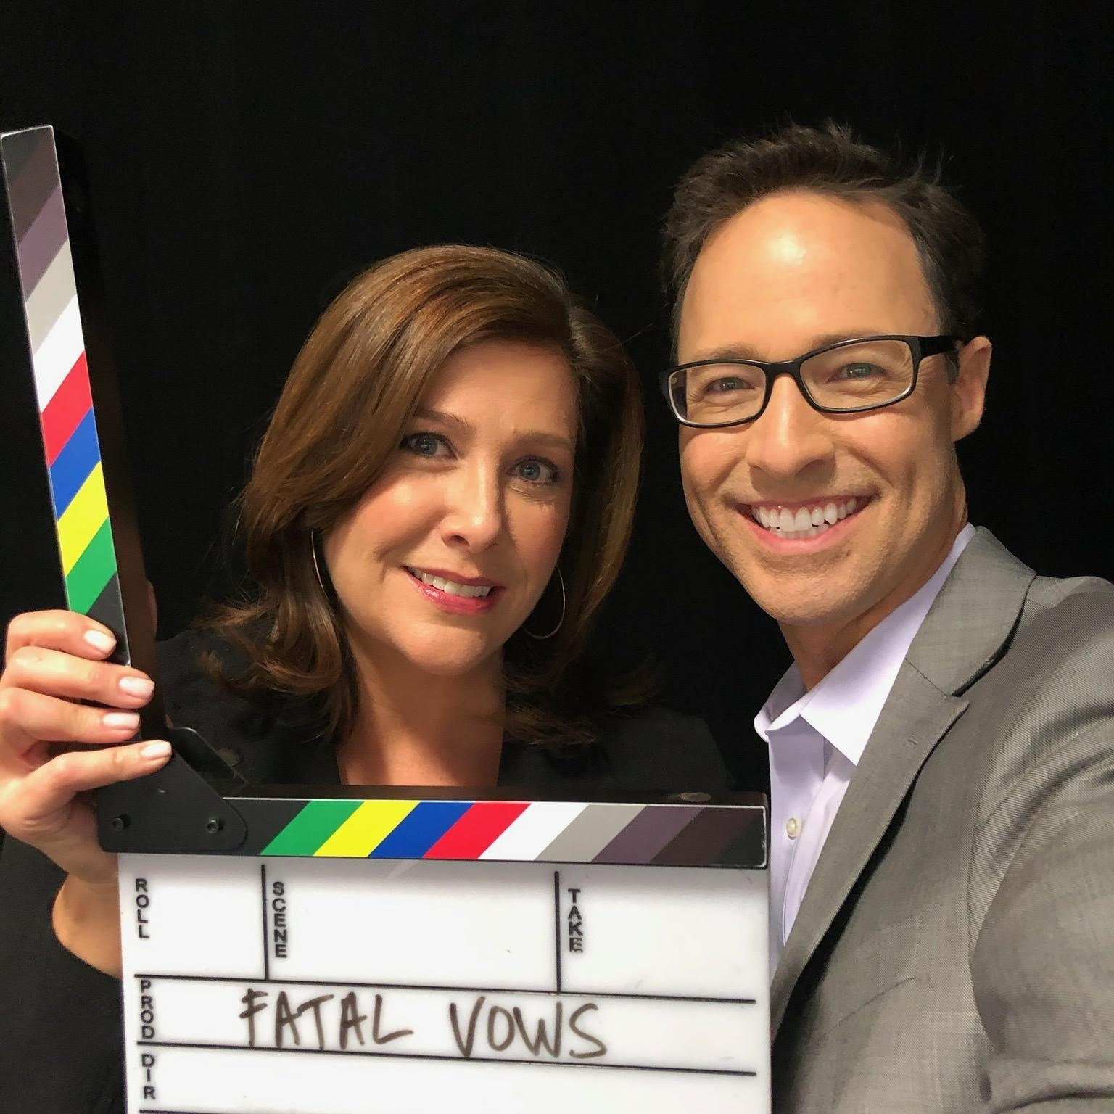
Fatal vows

Slide 3
Fatal vows
7 seasons
Scores of divorces
Scores of lawyers involved
Scores of litigants committing heinous acts
Scores of litigants becoming victims of such acts
While not typical, these stories remind matrimonial lawyers that divorce can be murder!

Slide 4
Kahler case (Season 1)
1995: Kraig & Karen Kahler marry
1991/1993/1999: Kids Emily/Lauren/Sean are born
2008: Karen begins a relationship with a woman; family moves from TX to MO
2009: Karen hears Kraig has had an affair, files for divorce
Kraig is arrested for battery, Karen gets PFA, Karen & kids move out
Kraig loses job, moves to KS
Karen & kids visit Karen’s grandmother in KS Thanksgiving weekend
Kraig goes to Karen’s grandmother’s house. shoots everyone but Sean
Karen, Emily, & Lauren die that day, Karen’s grandmother 3 days later
Kraig is arrested the next day walking down a country road
2011: Kraig gets death sentence (appealed to SCOTUS arguing he was denied
an insanity defense under KS law, lost—a topic for another talk!)

Slide 5
DIVORCE Danger zones
Temporal
Leadup (when it’s clear marriage’s days are numbered)
During (when lawyers are actively involved)
Aftermath (when it’s over, but not really)
Emotional
Hurt/Anger/Resentment
Fear/Desperation
Narcissism/Entitlement/Sociopathy

Slide 6
Potentially-Elevated risks
Disappearing Assets
False Accusations
Missing Children
Violence Toward Multiple Possible Victims
Spouse
Spouse’s Affair Partner
Self
Kids (& Potentially Other Relatives)

Slide 7
Tomassoni case (season 4)
1983: Gary & Helen Tomassoni marry
1985/1993: Kids Jack & Ryan are born
1989: Gary starts gambling at a local casino
2005: Gary wins $250,000 at the casino, pays off debts, takes Helen on trip
Gary continues gambling and loses a lot of what’s left of the money
Helen demands Gary stop & get treatment & he agrees to
2007: Helen is murdered in the marital home
Evidence shows Gary kept gambling, lost everything, mortgaged home
2008: Gary is convicted of murder for insurance money, gets 45 years

Slide 8
Disappearing assets
In many cases:
Diversion of marital assets predates divorce
  Gambling
  Affairs
Diversion of marital assets ramps up when divorce is impending
Lawyers can help stop the bleeding & recoup some lost assets or get offsets for clients

Slide 9
CasE of the fractured family
Early-career custody-evaluation case
Child had Osteogenesis Imperfecta
Parent A offered ER records to prove Parent B negligent & unfit
Statistical analysis of fractures showed:
More fractures occurred during Parent B’s parenting time
Parent B also had more parenting time
Controlling for parenting time, slightly more risk with Parent A
Parent A did not seem intentionally fraudulent
Parent A did seem angry with & disrespectful of Parent B, self-righteous, & desperate to minimize loss of parenting time

Slide 10
False accusations
In many cases:
Litigants falsely allege domestic violence.
Litigants falsely allege child abuse.
Sometimes, it’s deliberate (i.e., abusive in itself).
Other times, it’s genuinely believed yet still false.
Lawyers, too, can help whether representing accused or accuser (sometimes accusers think an accusation is their only hope or is justified by emotional abuse).

Slide 11
Case of the kidnapped kansans
2014: Mid-divorce, Bogdana Mobley flees to her native Russia taking:
Her daughter from a previous marriage
Her daughter with then-husband Brian Mobley, Sophia, now 6
Her then-unborn second child with Brian, Isabella, now 5
2014-2017: Bogdana lets Brian see the girls by Skype, demands cash for visits
2017: Bogdana returns to KS to file child-support paperwork
Arrested by FBI
Charged with international parental kidnapping & attempted extortion
2019: Bogdana gets 7 years for parental kidnapping & 2 extortion counts
2020: Fed. appeals court overturns extortion convictions, Bogdana is released having already served the max. for parental kidnapping, kids remain in Russia according to National Center for Missing & Exploited Children

Slide 12
Parental kidnapping
D.O.J. National Incidence Studies of Missing, Abducted, Runaway, and Throwaway Children (dated, early 2000s)
~200,000 cases in a yr. (9% of all kids who go missing)
Most taken from home (7% from school)
Usually were with perpetrator immediately prior
Almost always in divorce/split-custody situation
½ boys, ½ girls, 44% < age 6
Fathers more than twice as likely to perpetrate
Same racial breakdown as general population

Slide 13
Parental kidnapping, Continued
D.O.J. National Incidence Studies of Missing, Abducted, Runaway, and Throwaway Children
35% summer (Jun.-Aug.)
91% returned
  79% < 1 mo.
  46% < 1 wk.
  23% < 1 day
6% not returned but located
~2% not returned/located (deceased?, overseas?)

Slide 14
Vallow case
2003: Charles & Lori Vallow marry
2019: Charles petitions for divorce, alleges Lori threatened his life, gets a PFA
Charles petitions for full custody of their adopted son Joshua, 7
Charles alleges Lori said she was a god helping Christ to return in 2020
Charles then dismisses divorce petition
Charles is shot & killed by Lori’s brother, who claimed self-defense
Lori’s brother dies (of “natural causes” but under investigation)
Lori marries “widower” (since charged with murder) Chad Daybell
Joshua & Tylee (Lori’s daughter from a previous marriage, 17) go missing
2020: Joshua’s & Tylee’s remains found on Chad Daybell’s property
2021: Chad Daybell & Lori Vallow charged with the kids’ 1st-degree murders

Slide 15
Murder
Violence and Gender 2019
2237 domestic-partner homicides in 2017
  1527 female victims
  Doesn’t include homicides of/by affair partners

Slide 16
Divorce as precipitating factor
Chances of someone involved in a divorce getting murdered are higher when there has been:
Domestic-violence history
Infidelity
  Multiple potential perpetrators, motives, & victims
Financial trouble
  Window closing on opportunity &/or fear of future
Child-custody issues (especially fear of loss of custody)

Slide 17
Tragic outcomes
Financial devastation
Reputations ruined
Kids losing parents
Death
Long-term separation
  Kidnapping
  Prison (lasting conflict about what to believe)
Kids being killed

Slide 18
Tips for lawyers
Consider not offering free consultations for divorces (to discourage efforts to “conflict you out”).
Watch for erratic behavior (on either side).
Listen for erratic talk (e.g. , about “confronting” _____).
Counsel clients about realities of court orders (PFAs, custody...)
Keep a list of local resources
Psychologists (therapists as well as potential experts)
Shelters
Counsel clients about complications of “moving on” prematurely.
Review relevant professional-conduct rules.

Slide 19
Model Rule 1.6 (in part)
Rule 1.6, Confidentiality of Information, Client-Lawyer Relationship
(a) A lawyer shall not reveal information relating to the representation of a client unless the client gives informed consent, the disclosure is impliedly authorized in order to carry out the representation or the disclosure is permitted by paragraph (b).
(b) A lawyer may reveal information relating to the representation of a client to the extent the lawyer reasonably believes necessary:
(1) to prevent reasonably certain death or substantial bodily harm;

Slide 20
Model rule 1.16 (in part)
Model Rule 1.16, Declining or Terminating Representation
(b) Except as stated in paragraph (c), a lawyer may withdraw from representing a client if:
(4) the client insists upon taking action that the lawyer considers repugnant or with which the lawyer has a fundamental disagreement;

Slide 21
Model rule 1.18 (in part)
Model Rule 1.18, Duties to Prospective Client
(a) A person who consults with a lawyer about the possibility of forming a client-lawyer relationship with respect to a matter is a prospective client.
(b) Even when no client-lawyer relationship ensues, a lawyer who has learned information from a prospective client shall not use or reveal that information, except as Rule 1.9 would permit with respect to information of a former client.
(c) A lawyer subject to paragraph (b) shall not represent a client with interests materially adverse to those of a prospective client in the same or a substantially related matter if the lawyer received information from the prospective client that could be significantly harmful to that person in the matter, except as provided in paragraph (d). If a lawyer is disqualified from representation under this paragraph, no lawyer in a firm with which that lawyer is associated may knowingly undertake or continue representation in such a matter, except as provided in paragraph (d).

Slide 22
Model rule 3.1 (in part)
Model Rule 3.1, Meritorious Claims and Contentions
A lawyer shall not bring or defend a proceeding, or assert or controvert an issue therein, unless there is a basis in law and fact for doing so that is not frivolous, which includes a good faith argument for an extension, modification or reversal of existing law.

Slide 23
Model rule 3.4 (in part)
Model Rule 3.4, Fairness to Opposing Party and Counsel
A lawyer shall not:
(b) falsify evidence, counsel or assist a witness to testify falsely, or offer an inducement to a witness that is prohibited by law;
(e) in trial, allude to any matter that the lawyer does not reasonably believe is relevant or that will not be supported by admissible evidence, assert personal knowledge of facts in issue except when testifying as a witness, or state a personal opinion as to the justness of a cause, the credibility of a witness, the culpability of a civil litigant or the guilt or innocence of an accused; or
(f) request a person other than a client to refrain from voluntarily giving relevant information to another party unless:
(1) the person is a relative or an employee or other agent of a client; and
(2) the lawyer reasonably believes that the person's interests will not be adversely affected by refraining from giving such information.

Slide 24
Model rule 4.4 (in part)
Model Rule 4.4, Transactions With Persons Other Than Clients
(a) In representing a client, a lawyer shall not use means that have no substantial purpose other than to embarrass, delay, or burden a third person, or use methods of obtaining evidence that violate the legal rights of such a person.

